Slide 1

Third-Party Landing Zone (3PLZ) RFP Overview
Michael J. Martin
Network Security Engineering
Nov 2025

Slide 2

Contents
04
Overview
05
Benefits from Strategic Shift
06
Expected Outcomes
07
Initial Use Cases
08
Architectural View
09
Appendix

Slide 3
Case for Change: Third-Party Landing Zone
To address the security and operational issues of legacy connectivity models, we need to transition to a modern and automated solution that empowers application teams with self-service capabilities while ensuring strong compliance and scalability.
Overview
Current State
Future State
Unsupportable Legacy Models
Lack of isolation, auditability, and scalability.
Manual processes introduce inefficiencies and increase risk.
Modern Service-Oriented Capabilities
Transition to secure, repeatable, and compliant solutions.
Improved isolation, auditability, and scalability.
Inefficient Manual Processes
Security gaps reduce business agility.
Amplified challenges due to growing third-party interactions.
Automated Processes and Self-Service
Empower business units through self-service onboarding.
Automation enhances operational efficiency and reduces risks.
Increased Operational Risk
Evolving regulatory requirements and sophisticated cyber threats.
Lack of standardized security measures.
End-to-End Governance and Compliance
Standardized, automated approach for least privilege and segmentation.
Enhanced identity-aware controls ensure compliance and operational resilience.

Slide 4




Benefits from the Strategic Shift
The implementation of 3PLZ represents a strategic shift from viewing third-party connectivity and provides tangible business benefits.
Empowering Application Teams
Alignment with DevOps
Automation and Scalability
Operational Efficiency and Ownership
Centralized Visibility and Management
Enables application teams to independently manage connectivity through a self-service, outcome-driven model, reducing reliance on manual processes.
By allowing teams to build, run, and own their connections securely, this approach reinforces DevOps principles and promotes agility across the enterprise.
Automated delivery frameworks ensure consistent, repeatable, and scalable connectivity, while embedding compliance and governance controls into every step.
The strategic shift fosters enterprise-wide efficiency, reducing manual effort and reinforcing a culture of ownership and accountability for secure connectivity.
Provides a comprehensive view and control of third-party connections, enabling rapid identification and isolation during cyber events to protect CVS from potential threats.
North Star
To enable seamless, secure, and scalable connectivity across the enterprise by empowering teams with self-service capabilities, aligning with DevOps, and driving operational efficiency.

Slide 5
Expected Outcomes
Detailing the high-level overview of the vision for driving the transition of 3PLZ.
Standardized IPSec Connectivity
Delivers secure VPN connectivity supporting platforms like Cisco and Palo Alto.
Validated configurations ensure quick deployment with minimal data requirements.
Supports peer-to-peer routing for isolated communication.
Virtual and Secure Tenant Architecture
Operates with split-brain proxy model for separate routing domains.
Aligns with SOC 2, ISO 27001, and NIST standards for compliance.
Protects enterprise applications from external access.
Granular Access Control
Service-specific proxies enforce least privilege and segmentation.
Identity-aware controls ensure context-driven access decisions.
Delivers auditable, fine-grained access per-partner.
Repeatable, Compliant Connectivity
Streamlines onboarding with intuitive self-service portal.
Reduces manual effort while accelerating time-to-market.
Maintains strict compliance with industry security standards through automation.

Slide 6




Service Pattern Catalogue - Initial Use Cases
The platform is defined around five core service patterns – not just on raw network reachability.
Secure File Transfer
SFTP / SSH / MFT (e.g., IBM Sterling)
Collaboration Access
M365, eShare, Slack via proxied, logged access
Virtual Desktop (VDI)
Citrix / Microsoft VDI via pertenant proxies
Web Applications
Internal HTTPS apps via reverse proxies with mTLS
Web APIs
REST/SOAP APIs with mTLS and token/claim-based controls
Each pattern must support both Enterprise and Internet/SaaS paths

Slide 7





High-Level Architecture View
The architecture connects users seamlessly to our enterprise applications while ensuring robust isolation and compliance.
VPC Outbound IP Pool
Corporate Cloud
3PLZ Tenant
O365 Outbound IP Pool
VDI Service Connection
SharePoint Service Connection
Internet
Corp Internet App Path
VDI User
3rd Party
Corporate
Internet
Corporate
VLZ
WEB Service Connection
VLZ Outbound IP for APP YYY
3PLZ
Partner
Corp Internal App Path
API Service Connection
VLZ Outbound IP for YYY
Web App User
3rd Party DNS Declarative Forwarder Target
VLZ to Authoritative DNS
VLZ Authoritative DNS
3rd party users utilize their corporate DNS to resolve our enterprise targets
User application traffic is sent to the 3PLZ target IP’s (Provided By L3PLZ DNS Service).
Using platform optimized proxies, user sessions are connected to our corporate Internet or Intranet application.

Slide 8
Appendix

Slide 9
Self-Service Portal Experience
Appendix WIP
Web portal is the primary front door for application teams and product managers to deliver capabilities.
“Shift Left” Delivery approach.
Embracing the KISS principle.
Web and API driven delivery interface enabling easy adoption for both technical and not-technical users.
Service and pattern driven configuration, built on easily collected data.
No deep network expertise required for requestors. Portal delivers tested configurations based on well defined patterns.

Slide 10
Virtual Landing Zone (VLZ) & Tenant Model
Appendix WIP
Virtual Landing Zone
Secure Tenant Model
Each third-party connection is a dedicated tenant (VLZ)
Provides the enterprise side of the Peer 2 Peer IPSec tunnel
Single HA-FT IPSec Connection per VLZ
VLZ is a no-access zone: no direct routing to internal networks
Virtual Landing Zone is physical, but discrete (A tenant can have more than one VLZ)
A Tenant is logical (more than one VLZ can exist in a tenant)
Each tenant is a unique identity, mapped to a business identity
A VLZ is owned by tenant
Each VLZ is distinctive:
Address blocks
Tunnel interfaces,
EBGP ASN
DNS Resolver
Service Connections
Availability is built around applications using FQDN reachability

Slide 11
Service Patterns and Service Connections
Appendix WIP
Service Pattern
Service Connections
Users provide connectivity using application specific proxy configuration templates
SFTP/SSH proxy, VDI proxy, Web App proxy, Web API proxy, SaaS proxy
Each service has a set of templates that are optimized for different use cases (e.g., Internet Reachable Target, SFTP using blind key authentication)
Application owners define Service Profiles via the portal:
Choose service type (e.g., Enterprise Web App, Internet SaaS)
Provide FQDNs, ports, and header/path requirements
Select controls (IP restrictions, auth requirements, rate limiting)
Once the use case pattern is selected, to define a service connection all that is needed is the user to define the corporate FQDN application target.
Platform translates profiles into proxy configs, ACLs, and DNS rules
FQDN/IP defined application connections that are reachable by 3rd party users over the IPSec tunnel between the 3rd party network and the 3PLZ VLZ.
3Rd party users use there corporate DNS to resolve applications. VLZ DNS service rewrites DNS lookup requests to reflect the VLZ proxy address.
Reachability to application service connections can be tied to successful corporate DNS resolution and if needed remote hop verification tied to BGP announcements.

Slide 12
Sample Portal Form – Secure File Transfer Service-Pattern (SFTP Service-Connection VLZ Proxy)
Appendix WIP
Example fields collected in the portal
Validations & policy checks
Business context: application name, owner, environment (dev/test/prod)
Third-party details: organization name, contact info, support hours
Network endpoints: remote public IP/FQDN, device type/platform
Service specifics: SFTP hostnames, ports, internal target FQDNs
Data sensitivity & compliance tags (PHI/PII, region, retention)
Operational parameters: expected volume, schedules/maintenance windows
Required fields, allowed port ranges, approved cipher suites
Automatic mapping to a standard SFTP pattern and VLZ tenant
Routing to appropriate approvers and risk/compliance reviewers

Slide 13
Sample Portal Form – Web API (Enterprise API via VLZ Proxy)
Appendix WIP
Example fields collected in the portal
Validations & policy checks
Business context: application name, owner, environment (dev/test/uat/prod)
API details: API name, internal FQDN, base path (e.g., /v1/payments)
Third-party details: organization, contact, support window, region(s)
Network endpoints: remote public IP(s)/FQDN(s), expected source CIDRs
Auth & identity: auth type (mTLS, OAuth2/JWT, API key), required claims/scopes
Data classification: sensitivity (PHI/PII), residency, retention, logging level
Traffic profile: expected QPS, burst limits, concurrency, allowed methods
Required fields, allowed methods and ports, approved cipher suites
API classification drives mandatory controls (e.g., mTLS for high sensitivity)
Automatic mapping to a standard Web API pattern and VLZ tenant

Slide 14
Web API Service Behavior & Controls
Appendix WIP
Service proxy behavior
Security controls
Observability & governance
Exposes a tenant-specific API endpoint (e.g., https://<tenant-id>.api.3plz.example.com)
Forwards to internal API FQDN/base path using mTLS where supported
Normalizes paths, headers, and TLS parameters based on the Service Profile
Enforces allowed HTTP methods, paths, and rate limits per profile
Supports mTLS, JWT/OAuth2 validation, or API key verification
Optional IP/CIDR restrictions per third party / tenant
Request/response size limits and protocol sanity checks
Per-tenant logs with correlation IDs, status codes, latency, and auth outcome
Metrics export (QPS, error rates, throttling events) to observability stack
Logs tagged with tenant, vendor, application ID, and data classification

Slide 15
From Form → IPsec Configuration & B2B Transport
Appendix WIP
Each approved request generates a remote IPsec configuration bundle
IKEv2 parameters, proposals, and crypto settings
Tunnel interface addresses and BGP configuration (if applicable)
Config bundles must support major firewall/router platforms
Local side terminates on location-agnostic tunnel anchors
All tunnel creation driven by templates and portal data, not manual builds

Slide 16
Identity, DNS, and Observability
Appendix WIP
Identity & Authorization: RBAC roles in the portal and APIs
Tenant-linked identities influence policy decisions and approvals
DNS as a control plane: per-tenant views, split-horizon, conditional forwarding
Per-tenant logs for DNS, proxy traffic, and tunnel/BGP state
Logs and metrics must integrate with enterprise SIEM/observability tools

Slide 17
Automation & Scale Requirements
Appendix WIP
All portal operations available via documented APIs
Support for IaC tools (e.g., Terraform, Ansible) and CI/CD integration
Target scale: ~1000 tenants, multiple patterns per tenant
High availability for control and data planes
Standards-compliant crypto and minimal-disruption upgrades

Slide 18
Shared Responsibilities: Business vs Vendor Platform
Appendix WIP
Business responsibilities
Vendor platform responsibilities
Provide an application governance mechanism with Universal Application IDs
Provide a Universal Identifier for third-party partners (3pBID)
Supply Universal IDs and 3pBIDs to drive tenant creation and site-to-site VPN setup
Operate PKI processes to generate and deliver mTLS certificates for Web/WebAPI tenants
Operate enterprise IdPs (SAML/OAuth2/OIDC) for Virtual Tenant portal SSO and RBAC
Treat Universal IDs and 3pBIDs as first-class attributes in tenant and config APIs
Automate VPN and service proxy creation from portal data and identifiers
Integrate with enterprise PKI for certificate-based auth and renewal workflows
Integrate with enterprise IdPs for authentication and authorization to the portal

Slide 19
What We Expect in Vendor Responses
Describe end-to-end portal-driven workflows
From app owner request → IPsec config → service proxy live
Show how your platform implements the required service patterns
Demonstrate self-service forms that generate
Remote IPsec bundles, VLZ/tenant config, service proxy rules
Provide reference architectures, runbooks, and automation artifacts
Map capabilities to security, compliance, scale, and shared responsibility model

Slide 20
Third-Party Landing Zone (3PLZ) – RFP Overview
Vendor-Neutral Requirements for Self-Service Third-Party Connectivity Solution
Michael J. Martin
Network Security Engineering
Notes:
This deck summarizes the requirements for a Third-Party Landing Zone platform as defined in our RFP.
The key themes are vendor-neutral design, clear service patterns, a self-service portal experience, and strong automation.
We’re not looking for just another VPN product. We’re looking for a platform that application teams can consume through a web portal and APIs.

Slide 21
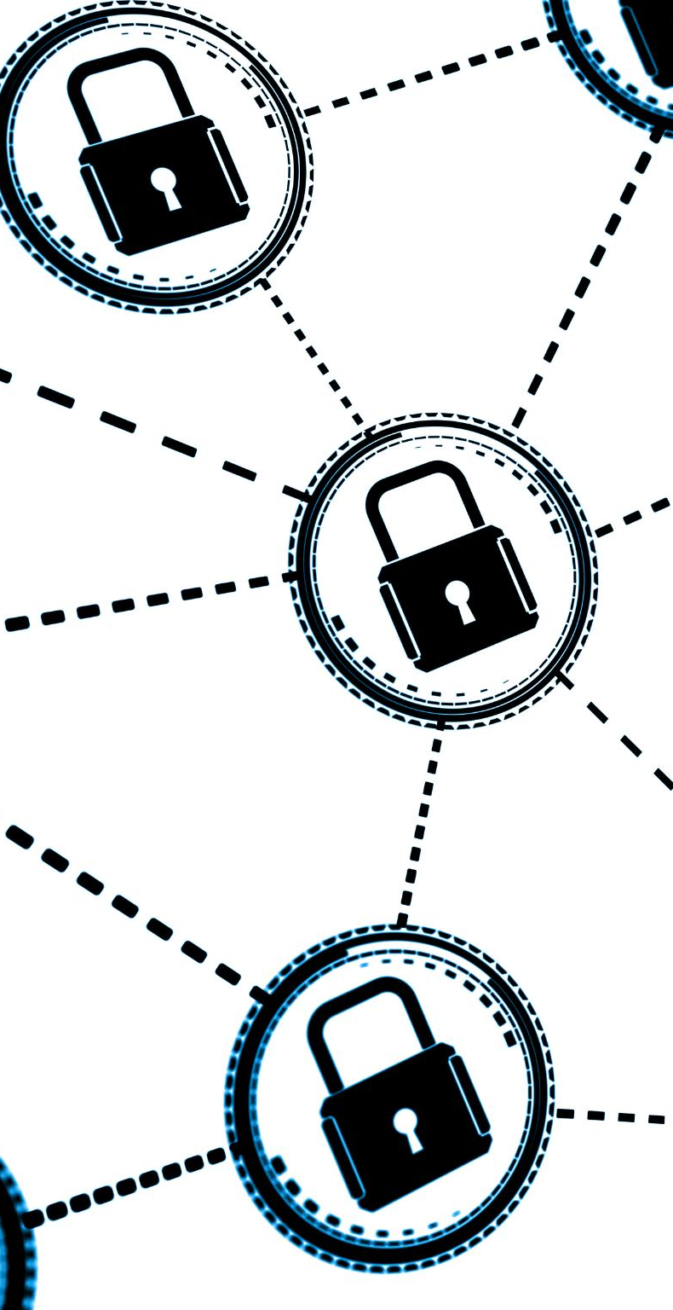
A Case For Change
Traditional enterprise approaches to third-party connectivity are no longer sufficient. They lack isolation, auditability, and scalability—creating security gaps and reducing business agility. Manual processes introduce inefficiencies and increase risk, while growing third-party interactions amplify these challenges. At the same time, evolving regulatory requirements and sophisticated cyber threats demand a standardized, automated approach that enforces least privilege, segmentation, and identity-aware controls to ensure compliance and operational resilience.
To address these challenges, the enterprise must transition from insecure, unsupportable legacy models to a modern, service-oriented capability. This new approach empowers business units through self-service onboarding, automation, and end-to-end governance, delivering a secure, repeatable, and compliant connectivity framework that accelerates time-to-market while reducing operational risk.
Notes:
Communication with external vendors is essential for business success, yet it introduces significant security and operational risks. Traditional connectivity models often lack the necessary isolation, auditability, and scalability required to safeguard enterprise applications. These models typically rely on manual processes that hinder agility and increase complexity, making it difficult for organizations to adapt quickly to evolving business needs. The absence of a standardized, secure, and automated approach to vendor connectivity exposes the enterprise to potential vulnerabilities and inefficiencies. As the volume and diversity of third-party interactions grow, the limitations of existing connectivity solutions become more pronounced, necessitating a transformative approach that addresses both technical and operational challenges.

Slide 22

Delivering Change a Strategic Shift
Empowering Application Teams This shift enables application teams to independently manage connectivity through a self-service, outcome-driven model, reducing reliance on centralized processes and accelerating delivery
Alignment with DevOps By allowing teams to build, run, and own their connections securely, this approach reinforces DevOps principles and promotes agility across the enterprise.
Automation and Scalability Automated delivery frameworks ensure consistent, repeatable, and scalable connectivity, while embedding compliance and governance controls into every step.
Operational Efficiency and Ownership The strategic shift fosters enterprise-wide efficiency, reducing manual effort and reinforcing a culture of ownership and accountability for secure connectivity.
Notes:
The implementation of the 3PLZ represents a strategic shift from viewing third-party connectivity as a purely technical product to delivering a self-service, process-outcome based solution. This new paradigm leverages automation to provide tangible business value, empowering application development teams to manage their own connectivity needs. By aligning with the DevOps philosophy of 'build, run, own,' the solution enables teams to migrate existing connections independently while maintaining adherence to security best practices. The self-service model fosters agility and innovation, allowing teams to respond quickly to changing requirements. Furthermore, the automated delivery framework ensures consistency and scalability, supporting enhanced capabilities and controls as the organization evolves. This shift not only improves operational efficiency but also reinforces a culture of ownership and accountability within the enterprise.

Slide 23
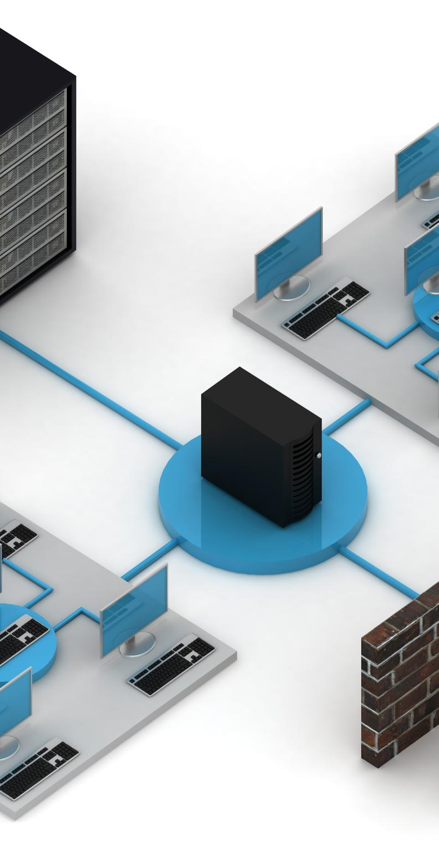
Proposed Way Forward: 3PLZ
Standardized IPSec Connectivity
The solution delivers secure, standardized IPSec VPN connectivity for third-party access, supporting leading platforms such as Cisco, Arista, Palo Alto, and Fortinet. Configurations are validated through virtual lab testing and require only basic, easily collectable data points for deployment. Connectivity supports peer-to-peer routing via BGP or static IP, restricted exclusively between the Virtual Tenant and the third-party network. All communication between third parties and the enterprise occurs through application-specific proxies, ensuring isolation and security. The architecture employs Active/Passive HA with a single tunnel design, featuring unique per-tenant IP tunnel endpoints for clear segmentation.
Virtual Tenant Architecture
The Virtual Landing Zone operates on a split-brain proxy model, maintaining separate routing domains for third-party and enterprise environments. It includes DNS rewriting capabilities, enabling declarative forwarding for enterprise domains (public and private FQDNs), with responses contingent on successful authoritative lookups. A unique per-tenant/proxy addressing model ensures strong isolation and traceability across all connections.
Notes:
This slide summarizes the strategic and architectural foundation of the Third-Party Landing Zone. Our goal is to deliver secure, repeatable, and compliant connectivity for third-party use cases.
The solution is built on a VPN-based architecture that isolates external access and enforces granular controls through service-specific proxies. These proxies support least privilege, segmentation, and auditable access, ensuring that vendor interactions are tightly governed.
Automation and self-service onboarding reduce manual operations, improving agility and scalability. The platform aligns with key compliance frameworks like SOC 2, ISO 27001, and NIST standards, while also incorporating identity-aware controls and high availability to support enterprise-grade reliability.

Slide 24
Vision for A 3rd Party Landing Zone
Secure Tenant Architecture
Deliver a secure and compliant third-party connectivity solution by implementing IPSec VPN tunnels to a Virtual Landing Zone, ensuring isolation and protection of enterprise applications from external access. This architecture aligns with SOC 2, ISO 27001, and NIST CSF / 800-171 / 800-207 standards, providing a governance-driven approach that meets regulatory and security requirements.
Granular Access Control
Enforce per-partner connectivity through service-specific proxies within the Virtual Landing Zone, applying least-privilege principles and segmentation to deliver auditable, fine-grained access. Identity-aware controls strengthen the security posture by ensuring access decisions are context-driven and aligned with organizational policies.
Repeatable, Compliant Connectivity through Automation and Self-Service Onboarding
Streamline partner onboarding and minimize manual effort, accelerating time-to-market while enhancing governance and reducing operational risk. Delivered via an intuitive self-service portal, this solution provides a secure, standardized connectivity framework with a pre-hardened environment for quick, consistent onboarding. Easy-to-deploy interfaces and minimal configuration ensure a seamless experience while maintaining strict compliance with industry security standards.
Notes:
This slide summarizes the strategic and architectural foundation of the Third-Party Landing Zone. Our goal is to deliver secure, repeatable, and compliant connectivity for third-party use cases.
The solution is built on a VPN-based architecture that isolates external access and enforces granular controls through service-specific proxies. These proxies support least privilege, segmentation, and auditable access, ensuring that vendor interactions are tightly governed.
Automation and self-service onboarding reduce manual operations, improving agility and scalability. The platform aligns with key compliance frameworks like SOC 2, ISO 27001, and NIST standards, while also incorporating identity-aware controls and high availability to support enterprise-grade reliability.

Slide 25






Service Pattern Catalog (Initial Use Cases)
Secure File Transfer – SFTP / SSH / MFT (e.g., IBM Sterling)
Collaboration Access – M365, eShare, Slack via proxied, logged access
Virtual Desktop (VDI) – Citrix / Microsoft VDI via per-tenant proxies
Web Applications – Internal HTTPS apps via reverse proxies with mTLS
Web APIs – REST/SOAP APIs with mTLS and token/claim-based controls
Each pattern must support both Enterprise and Internet/SaaS paths
Notes:
The platform is defined around service patterns, not raw network reachability.
We require at least five core patterns: secure file transfer; collaboration access; virtual desktop; internal web applications; and web APIs.
Each pattern must be implemented as an opinionated, secure service, with per-tenant proxies and policies.
We expect support for both enterprise paths, where traffic terminates in internal environments, and internet or SaaS paths, where traffic goes through controlled egress to external services.

Slide 26
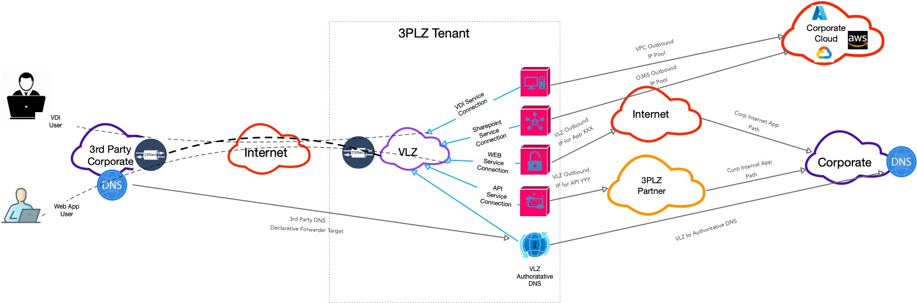
High Level Architectural View
3rd party users utilize their corporate DNS to resolve our enterprise targets. User application traffic is sent to the 3PLZ target IP’s (Provided By L3PLZ DNS Service). User sessions are then connected (using platform optimized proxies) to our corporate Internet or Intranet application.
Notes:
The platform is defined around service patterns, not raw network reachability.
We require at least five core patterns: secure file transfer; collaboration access; virtual desktop; internal web applications; and web APIs.
Each pattern must be implemented as an opinionated, secure service, with per-tenant proxies and policies.
We expect support for both enterprise paths, where traffic terminates in internal environments, and internet or SaaS paths, where traffic goes through controlled egress to external services.

Slide 27
Appendix
Notes:
The platform is defined around service patterns, not raw network reachability.
We require at least five core patterns: secure file transfer; collaboration access; virtual desktop; internal web applications; and web APIs.
Each pattern must be implemented as an opinionated, secure service, with per-tenant proxies and policies.
We expect support for both enterprise paths, where traffic terminates in internal environments, and internet or SaaS paths, where traffic goes through controlled egress to external services.

Slide 28
Self-Service Portal Experience
Web portal is the primary front door for application teams and product managers to deliver capabilities.
“Shift Left” Delivery approach.
Embracing the KISS principle.
Web and API driven delivery interface enabling easy adoption for both technical and not-technical users.
Service and pattern driven configuration, built on easily collected data
No deep network expertise required for requestors. Portal delivers tested configurations based on well defined patterns.
Notes:
The platform is defined around service patterns, not raw network reachability.
We require at least five core patterns: secure file transfer; collaboration access; virtual desktop; internal web applications; and web APIs.
Each pattern must be implemented as an opinionated, secure service, with per-tenant proxies and policies.
We expect support for both enterprise paths, where traffic terminates in internal environments, and internet or SaaS paths, where traffic goes through controlled egress to external services.

Slide 29
Virtual Landing Zone (VLZ) & Tenant Model
Virtual Landing Zone
Secure Tenant Model
Each third-party connection is a dedicated tenant (VLZ)
Provides the enterprise side of the Peer 2 Peer IPSec tunnel
Single HA-FT IPSec Connection per VLZ
VLZ is a no-access zone: no direct routing to internal networks
Virtual Landing Zone is physical, but discrete (A tenant can have more than one VLZ)
A Tenant is logical (more than one VLZ can exist in a tenant)
Each tenant is a unique identity, mapped to a business identity
A VLZ is owned by tenant
Each VLZ is distinctive:
Address blocks
Tunnel interfaces,
EBGP ASN
DNS Resolver
Service Connections
Availability is built around applications using FQDN reachability
Notes:
The platform is defined around service patterns, not raw network reachability.
We require at least five core patterns: secure file transfer; collaboration access; virtual desktop; internal web applications; and web APIs.
Each pattern must be implemented as an opinionated, secure service, with per-tenant proxies and policies.
We expect support for both enterprise paths, where traffic terminates in internal environments, and internet or SaaS paths, where traffic goes through controlled egress to external services.

Slide 30
Service Patterns and Service Connections
Service Pattern
Service Connections
Users provide connectivity using application specific proxy configuration templates
SFTP/SSH proxy, VDI proxy, Web App proxy, Web API proxy, SaaS proxy
Each service has a set of templates that are optimized for different use cases (e.g., Internet Reachable Target, SFTP using blind key authentication)
Application owners define Service Profiles via the portal:
Choose service type (e.g., Enterprise Web App, Internet SaaS)
Provide FQDNs, ports, and header/path requirements
Select controls (IP restrictions, auth requirements, rate limiting)
Once the use case pattern is selected, to define a service connection all that is needed is the user to define the corporate FQDN application target.
Platform translates profiles into proxy configs, ACLs, and DNS rules
FQDN/IP defined application connections that are reachable by 3rd party users over the IPSec tunnel between the 3rd party network and the 3PLZ VLZ.
3Rd party users use there corporate DNS to resolve applications. VLZ DNS service rewrites DNS lookup requests to reflect the VLZ proxy address.
Reachability to application service connections can be tied to successful corporate DNS resolution and if needed remote hop verification tied to BGP announcements.
Notes:
The platform is defined around service patterns, not raw network reachability.
We require at least five core patterns: secure file transfer; collaboration access; virtual desktop; internal web applications; and web APIs.
Each pattern must be implemented as an opinionated, secure service, with per-tenant proxies and policies.
We expect support for both enterprise paths, where traffic terminates in internal environments, and internet or SaaS paths, where traffic goes through controlled egress to external services.

Slide 31
Sample Portal Form – Secure File Transfer Service-Pattern (SFTP Service-Connection VLZ Proxy)
Example fields collected in the portal:
Business context: application name, owner, environment (dev/test/prod)
Third-party details: organization name, contact info, support hours
Network endpoints: remote public IP/FQDN, device type/platform
Service specifics: SFTP hostnames, ports, internal target FQDNs
Data sensitivity & compliance tags (PHI/PII, region, retention)
Operational parameters: expected volume, schedules/maintenance windows
Validations & policy checks:
Required fields, allowed port ranges, approved cipher suites
Automatic mapping to a standard SFTP pattern and VLZ tenant
Routing to appropriate approvers and risk/compliance reviewers
Notes:
The platform is defined around service patterns, not raw network reachability.
We require at least five core patterns: secure file transfer; collaboration access; virtual desktop; internal web applications; and web APIs.
Each pattern must be implemented as an opinionated, secure service, with per-tenant proxies and policies.
We expect support for both enterprise paths, where traffic terminates in internal environments, and internet or SaaS paths, where traffic goes through controlled egress to external services.

Slide 32
Sample Portal Form – Web API (Enterprise API via VLZ Proxy)
Example fields collected in the portal:
Business context: application name, owner, environment (dev/test/uat/prod)
API details: API name, internal FQDN, base path (e.g., /v1/payments)
Third-party details: organization, contact, support window, region(s)
Network endpoints: remote public IP(s)/FQDN(s), expected source CIDRs
Auth & identity: auth type (mTLS, OAuth2/JWT, API key), required claims/scopes
Data classification: sensitivity (PHI/PII), residency, retention, logging level
Traffic profile: expected QPS, burst limits, concurrency, allowed methods
Validations & policy checks:
Required fields, allowed methods and ports, approved cipher suites
API classification drives mandatory controls (e.g., mTLS for high sensitivity)
Automatic mapping to a standard Web API pattern and VLZ tenant
Notes:
The platform is defined around service patterns, not raw network reachability.
We require at least five core patterns: secure file transfer; collaboration access; virtual desktop; internal web applications; and web APIs.
Each pattern must be implemented as an opinionated, secure service, with per-tenant proxies and policies.
We expect support for both enterprise paths, where traffic terminates in internal environments, and internet or SaaS paths, where traffic goes through controlled egress to external services.

Slide 33
Web API Service Behavior & Controls
Service proxy behavior:
Exposes a tenant-specific API endpoint (e.g., https://<tenant-id>.api.3plz.example.com)
Forwards to internal API FQDN/base path using mTLS where supported
Normalizes paths, headers, and TLS parameters based on the Service Profile
Security controls:
Enforces allowed HTTP methods, paths, and rate limits per profile
Supports mTLS, JWT/OAuth2 validation, or API key verification
Optional IP/CIDR restrictions per third party / tenant
Request/response size limits and protocol sanity checks
Observability & governance:
Per-tenant logs with correlation IDs, status codes, latency, and auth outcome
Metrics export (QPS, error rates, throttling events) to observability stack
Logs tagged with tenant, vendor, application ID, and data classification
Notes:
The platform is defined around service patterns, not raw network reachability.
We require at least five core patterns: secure file transfer; collaboration access; virtual desktop; internal web applications; and web APIs.
Each pattern must be implemented as an opinionated, secure service, with per-tenant proxies and policies.
We expect support for both enterprise paths, where traffic terminates in internal environments, and internet or SaaS paths, where traffic goes through controlled egress to external services.

Slide 34
From Form → IPsec Configuration & B2B Transport
Each approved request generates a remote IPsec configuration bundle
IKEv2 parameters, proposals, and crypto settings
Tunnel interface addresses and BGP configuration (if applicable)
Config bundles must support major firewall/router platforms
Local side terminates on location-agnostic tunnel anchors
All tunnel creation driven by templates and portal data, not manual builds
Notes:
The platform is defined around service patterns, not raw network reachability.
We require at least five core patterns: secure file transfer; collaboration access; virtual desktop; internal web applications; and web APIs.
Each pattern must be implemented as an opinionated, secure service, with per-tenant proxies and policies.
We expect support for both enterprise paths, where traffic terminates in internal environments, and internet or SaaS paths, where traffic goes through controlled egress to external services.

Slide 35
Identity, DNS, and Observability
Identity & Authorization: RBAC roles in the portal and APIs
Tenant-linked identities influence policy decisions and approvals
DNS as a control plane: per-tenant views, split-horizon, conditional forwarding
Per-tenant logs for DNS, proxy traffic, and tunnel/BGP state
Logs and metrics must integrate with enterprise SIEM/observability tools
Notes:
The platform is defined around service patterns, not raw network reachability.
We require at least five core patterns: secure file transfer; collaboration access; virtual desktop; internal web applications; and web APIs.
Each pattern must be implemented as an opinionated, secure service, with per-tenant proxies and policies.
We expect support for both enterprise paths, where traffic terminates in internal environments, and internet or SaaS paths, where traffic goes through controlled egress to external services.

Slide 36
Automation & Scale Requirements
All portal operations available via documented APIs
Support for IaC tools (e.g., Terraform, Ansible) and CI/CD integration
Target scale: ~1000 tenants, multiple patterns per tenant
High availability for control and data planes
Standards-compliant crypto and minimal-disruption upgrades
Notes:
The platform is defined around service patterns, not raw network reachability.
We require at least five core patterns: secure file transfer; collaboration access; virtual desktop; internal web applications; and web APIs.
Each pattern must be implemented as an opinionated, secure service, with per-tenant proxies and policies.
We expect support for both enterprise paths, where traffic terminates in internal environments, and internet or SaaS paths, where traffic goes through controlled egress to external services.

Slide 37
Shared Responsibilities: Business vs Vendor Platform
Business responsibilities:
Provide an application governance mechanism with Universal Application IDs
Provide a Universal Identifier for third-party partners (3pBID)
Supply Universal IDs and 3pBIDs to drive tenant creation and site-to-site VPN setup
Operate PKI processes to generate and deliver mTLS certificates for Web/WebAPI tenants
Operate enterprise IdPs (SAML/OAuth2/OIDC) for Virtual Tenant portal SSO and RBAC
Vendor platform responsibilities:
Treat Universal IDs and 3pBIDs as first-class attributes in tenant and config APIs
Automate VPN and service proxy creation from portal data and identifiers
Integrate with enterprise PKI for certificate-based auth and renewal workflows
Integrate with enterprise IdPs for authentication and authorization to the portal
Notes:
This slide sets clear expectations on what the business provides versus what we expect from the vendor platform.
On the business side, we must provide an application governance mechanism that issues Universal Application IDs and a Universal Identifier for third-party partners, the 3pBID.
Those identifiers are used to create and label site-to-site VPN connections between partners and Virtual Tenants and to identify entities when generating mTLS certificates for Web and Web API connections.
The business is also responsible for operating PKI processes to generate and securely deliver mTLS certificates, and for providing SAML/OAuth2/OIDC identity providers for SSO and role-based access to the Virtual Tenant portal.
On the vendor side, the platform must consume these identifiers as first-class attributes in the tenant model and configuration APIs, automatically build VPNs and service proxies from portal data, and integrate cleanly with our PKI and identity providers.
This division of responsibilities makes it clear that governance, identity, and certificate issuance remain enterprise functions, while the vendor focuses on automation, enforcement, and integration.

Slide 38
What We Expect in Vendor Responses
Describe end-to-end portal-driven workflows:
From app owner request → IPsec config → service proxy live
Show how your platform implements the required service patterns
Demonstrate self-service forms that generate:
Remote IPsec bundles, VLZ/tenant config, service proxy rules
Provide reference architectures, runbooks, and automation artifacts
Map capabilities to security, compliance, scale, and shared responsibility model
Notes:
This final slide summarizes what we want to see in responses.
Vendors should describe end-to-end workflows starting from an application owner using the portal, through approval, to automated IPsec and service proxy deployment.
They should show how their platform implements each of the required service patterns in a vendor-neutral, standards-based way.
We expect concrete evidence of self-service forms that generate remote IPsec bundles, VLZ tenant configuration, and proxy rules, plus reference architectures, runbooks, and automation artifacts.
Finally, responses should map capabilities not only to our security, compliance, and scalability requirements, but also to the shared responsibility model between the business and the vendor platform.

